Slide 1

By: Manas Tuwani

Slide 2
CONDITIONAL STATEMENTS
We are using conditional statements to check/verify the conditions in Java program.
There are four different types of conditional statements available in Java.
1. If Condition
2. If else Condition
3. If else if condition/ nested if condition
4. Switch Case

Slide 3
If Condition
We are using if statement to check/verify the condition and will get the output only when the condition is true. We will not get the output if the condition is false.
Syntax:
If (Condition) {
Statement; }

Slide 4
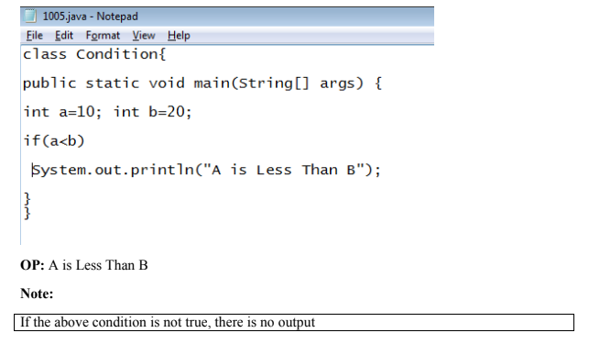
If Condition

Slide 5
If Else Condition
We are using if else statement to check/verify the condition and will get the output even though the condition is true/false.
Syntax:
if (Condition)
Statement1;
else
Statement2;

Slide 6
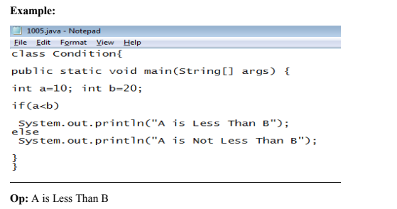
If Else Condition

Slide 7
If Else If condition / Nested If Condition
We are using these statement to verify the condition and tool will print the output if the condition is true or it will check the next condition if the condition is false.
Syntax:
If (condition1)
Statement 1;
Else
If (condition 2)
Statement 2;
Else
If (condition 3)
Statement 3;
Else
Statement 4;

Slide 8
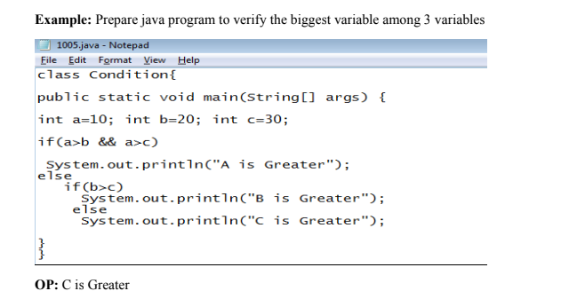
If Else If condition / Nested If Condition

Slide 9
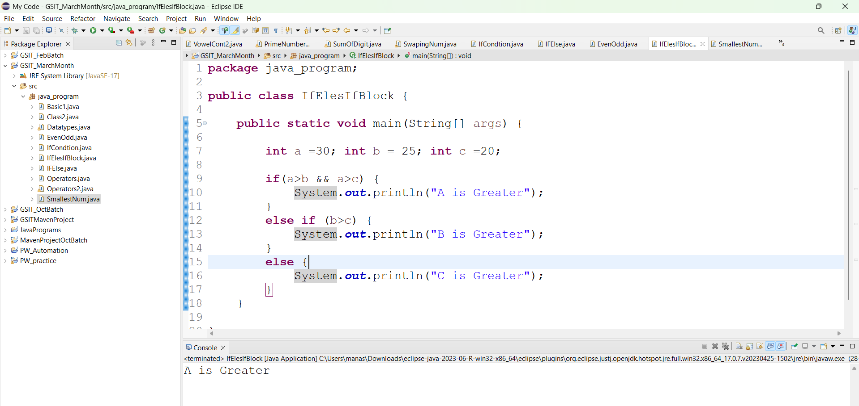

Slide 10
Practice Problem
Prepare java Program to verify biggest variable among 4 variables
class Condition{
public static void main(String[] args) {
int a=10; int b=20; int c=30; int d=40;
}
}

Slide 11
Switch Case
We are using this statement to verify multiple conditions at a time in JAVA program. Switch Case statement allows you to execute one block of code out of many based on the value of a variable
Syntax:
switch (variable/value) {
case 1:
Statement 1;
Break;
case 2:
Statement 2;
Break;
case 3:
Statement 3;
Break;
Default:
Statement;
Break;

Slide 12
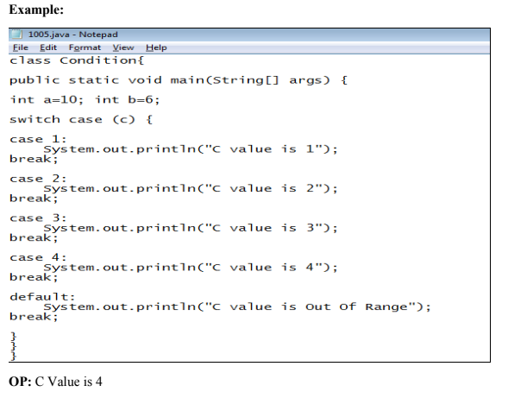
Switch Case

Slide 13
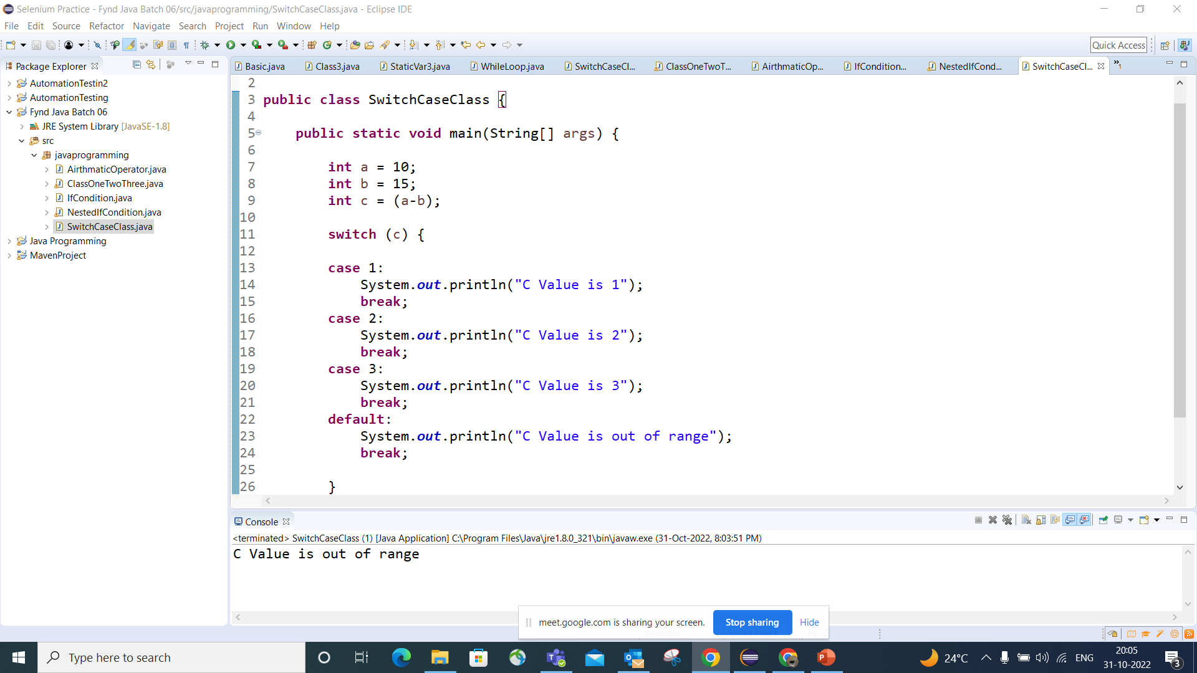

Slide 14
